Slide 1
BANK MANAGEMENT APPLICATION
Presented By:
Sarvagya Singhal
Gadari Ramya
Sirikonda Sathwika
Divya Teja

Slide 2
Content
Reference Document
Source Code (Version 1 & 2 )
Console View
Database View
Test Plan
Test Scenario
Test Cases
Defect Log
RTM
Automation Project
GitHub link

Slide 3
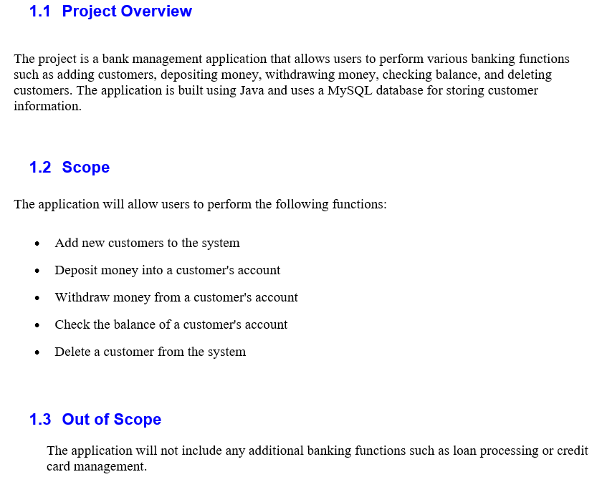
Reference Document

Slide 4
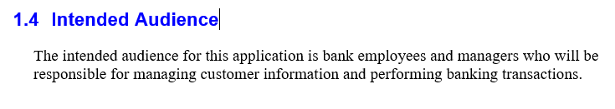
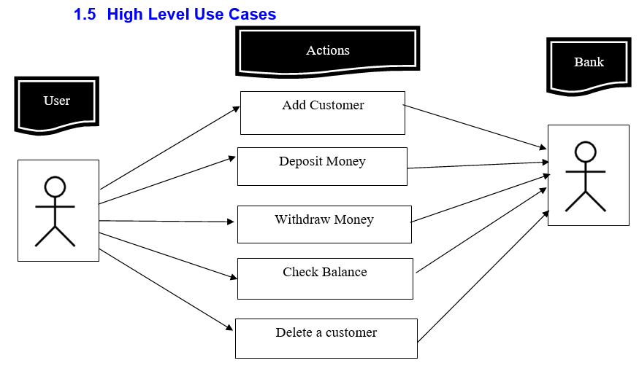

Slide 5
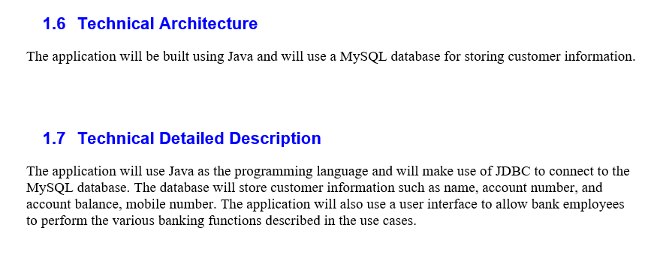

Slide 6
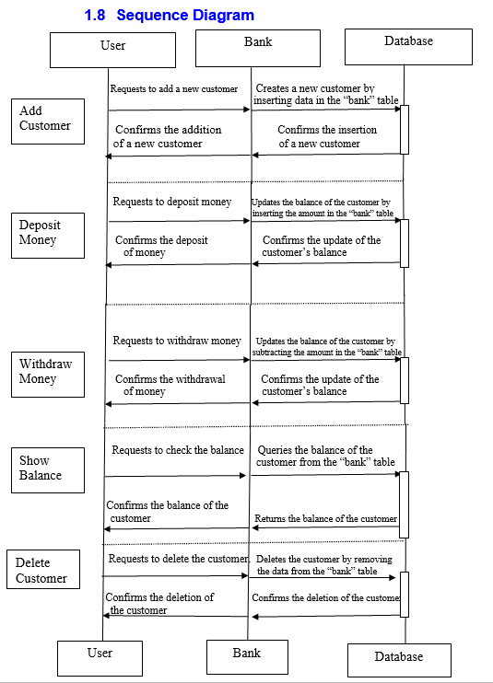

Slide 7
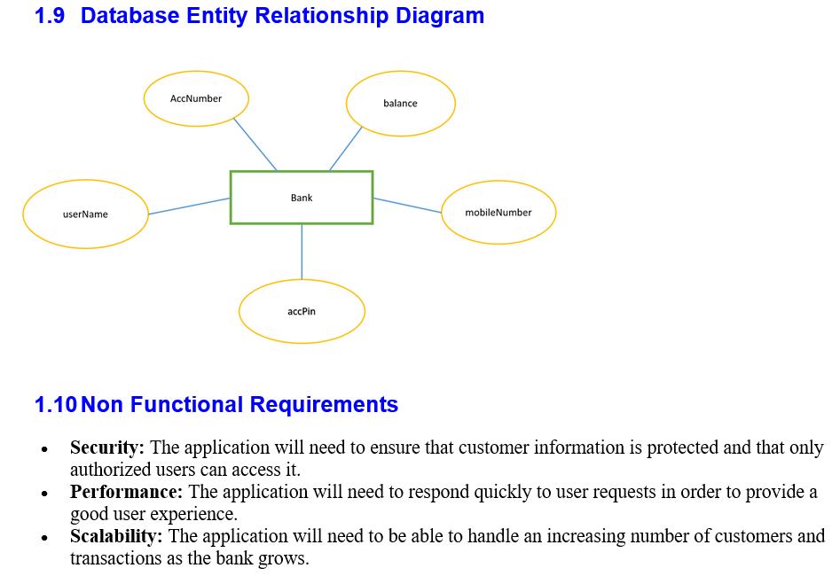

Slide 8
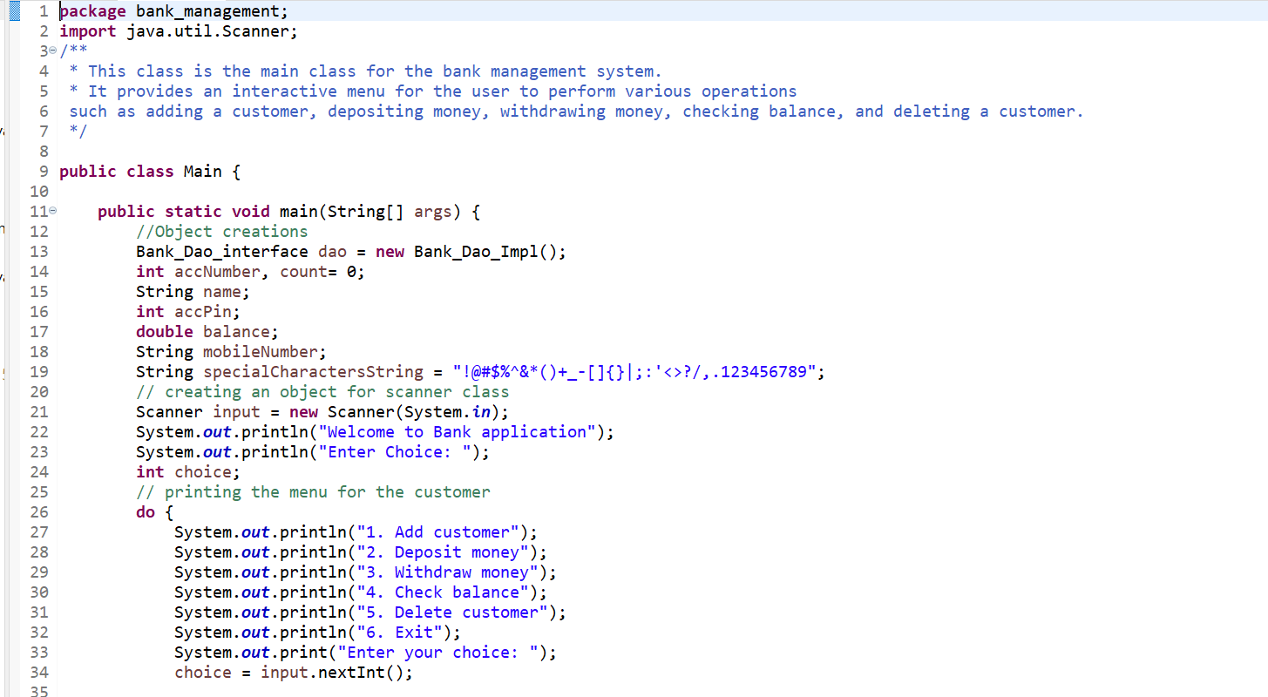
Source Code: Main.java

Slide 9
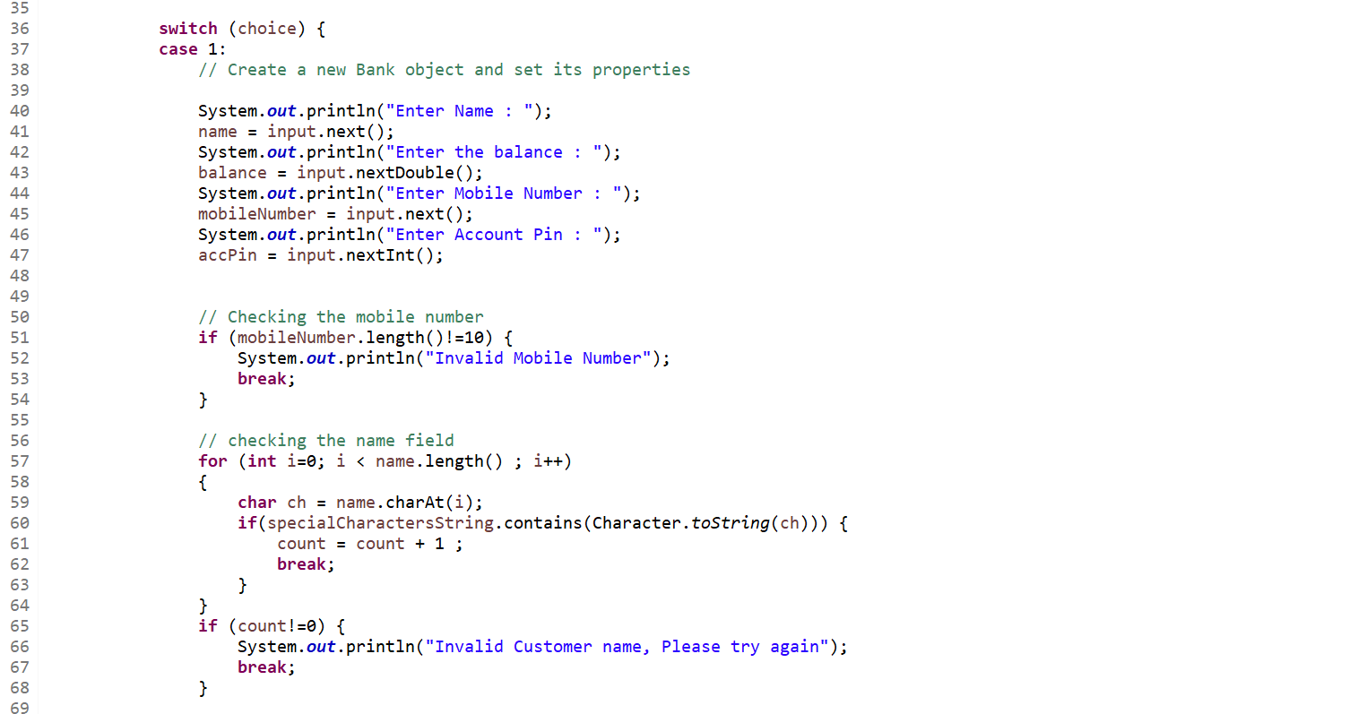
Source Code: Main.java

Slide 10
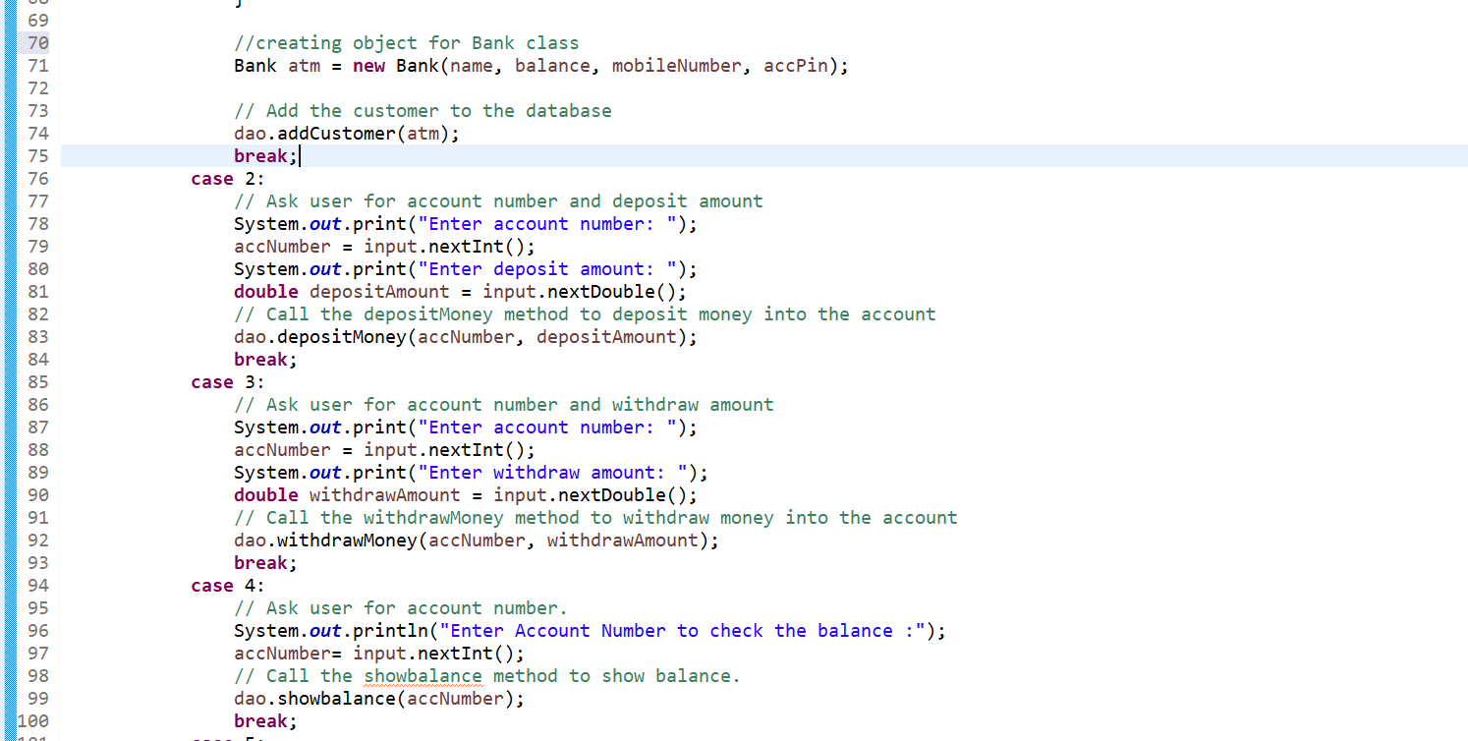
Source Code: Main.java

Slide 11
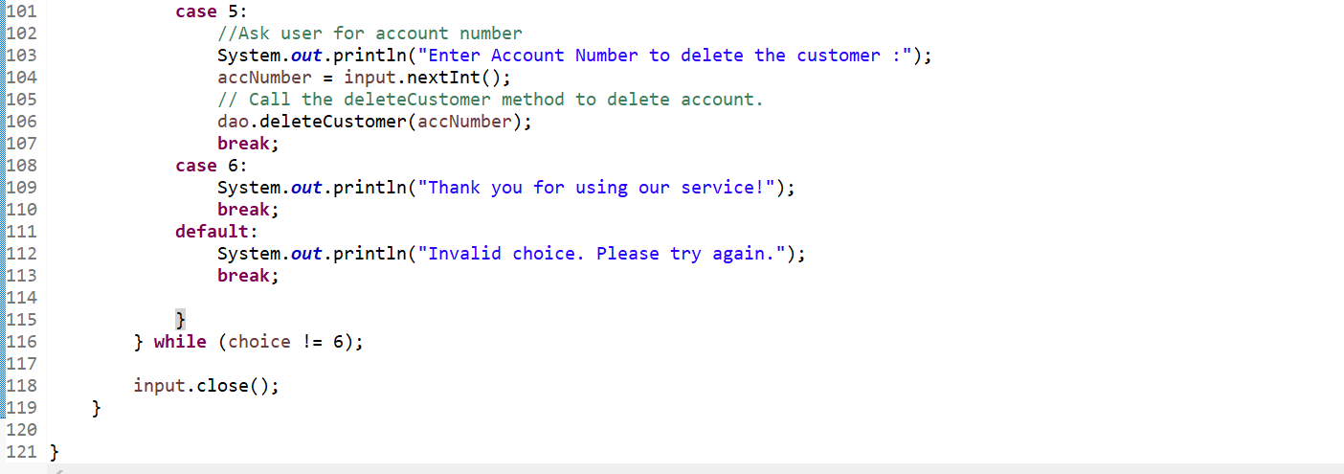
Source Code: Main.java

Slide 12
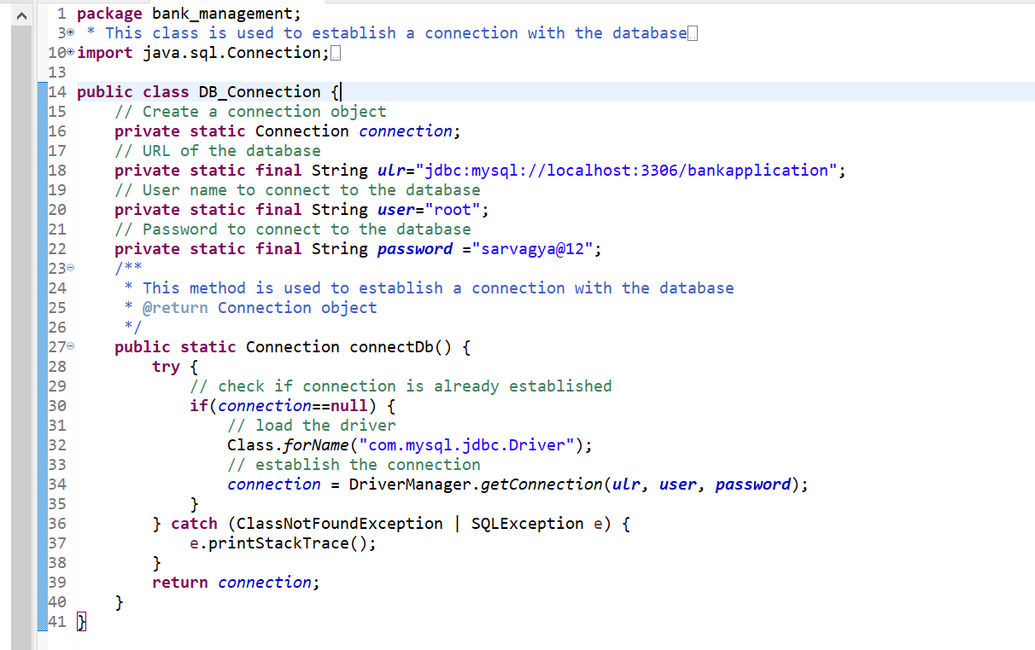
Source Code: DB_Connection.java

Slide 13
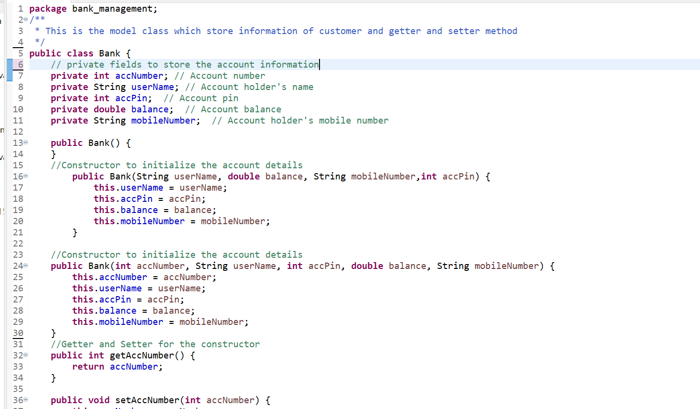
Source Code: Bank.java

Slide 14
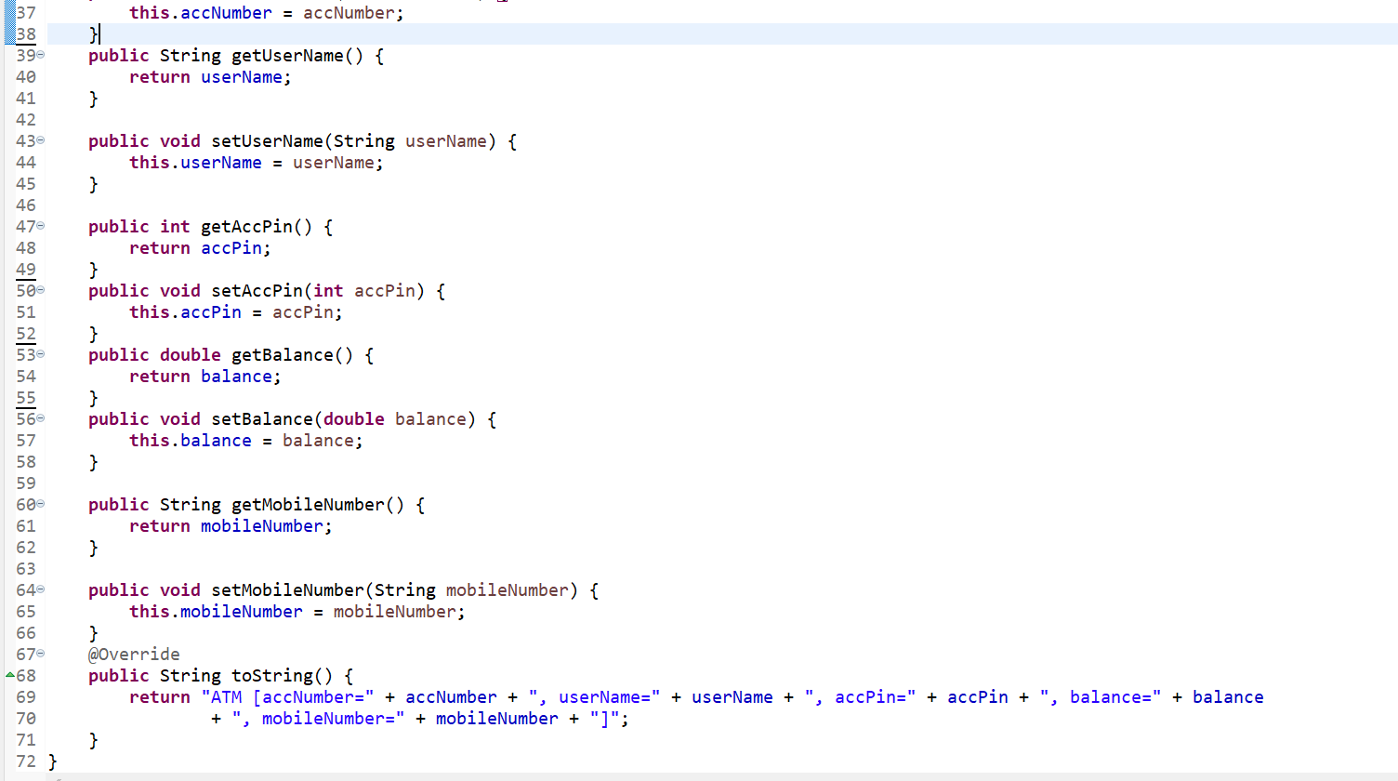
Source Code: Bank.java

Slide 15
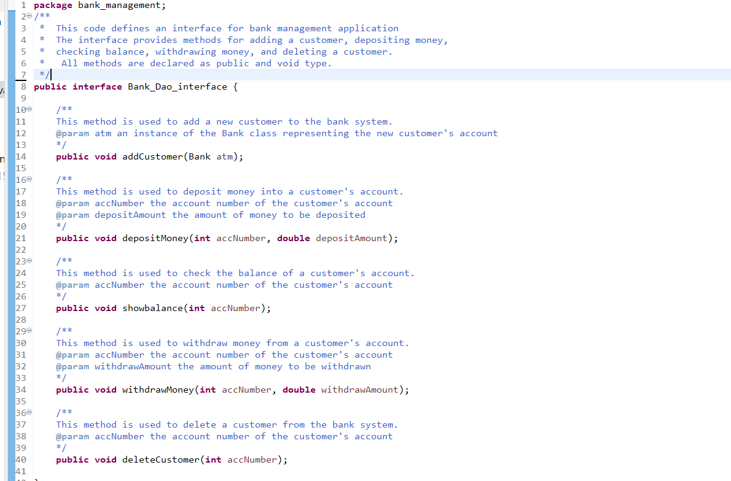
Source Code: Bank_Dao_interface.java

Slide 16
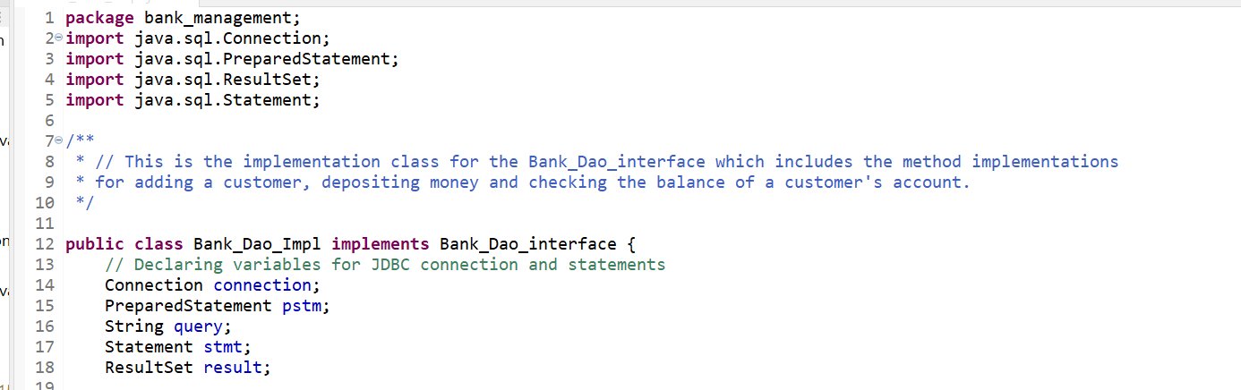
Source Code: Bank_Dao_Impl.java

Slide 17
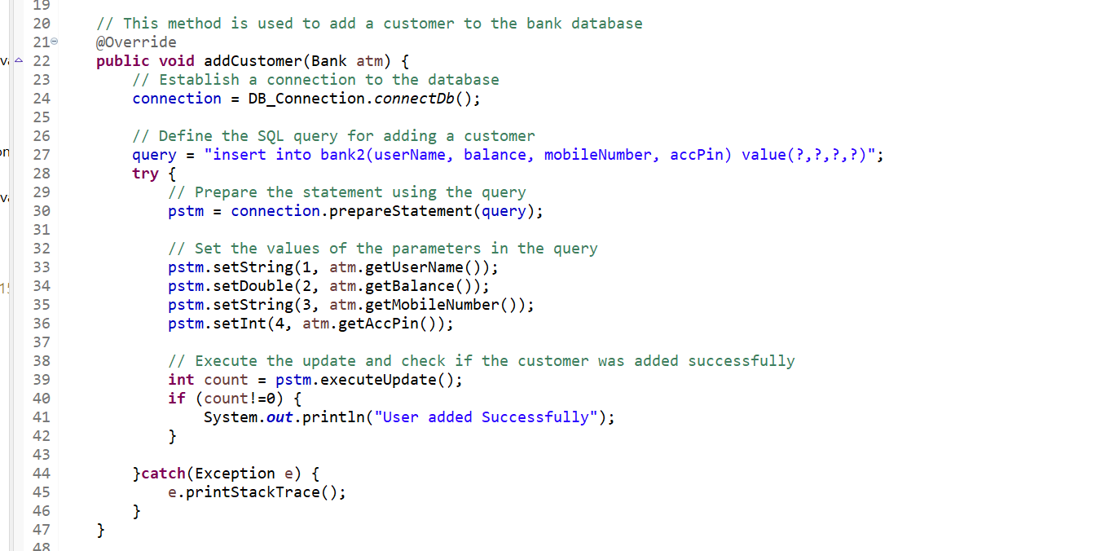
Source Code: Bank_Dao_Impl.java

Slide 18
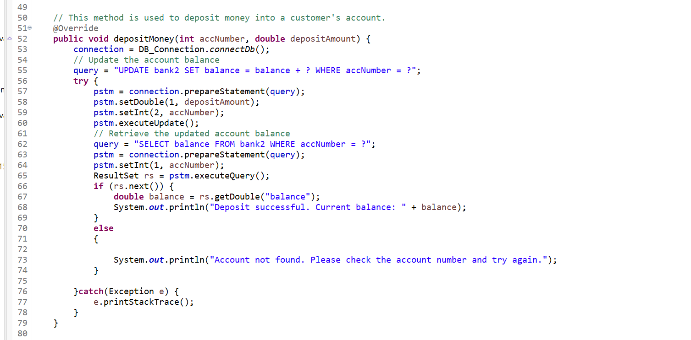
Source Code: Bank_Dao_Impl.java

Slide 19
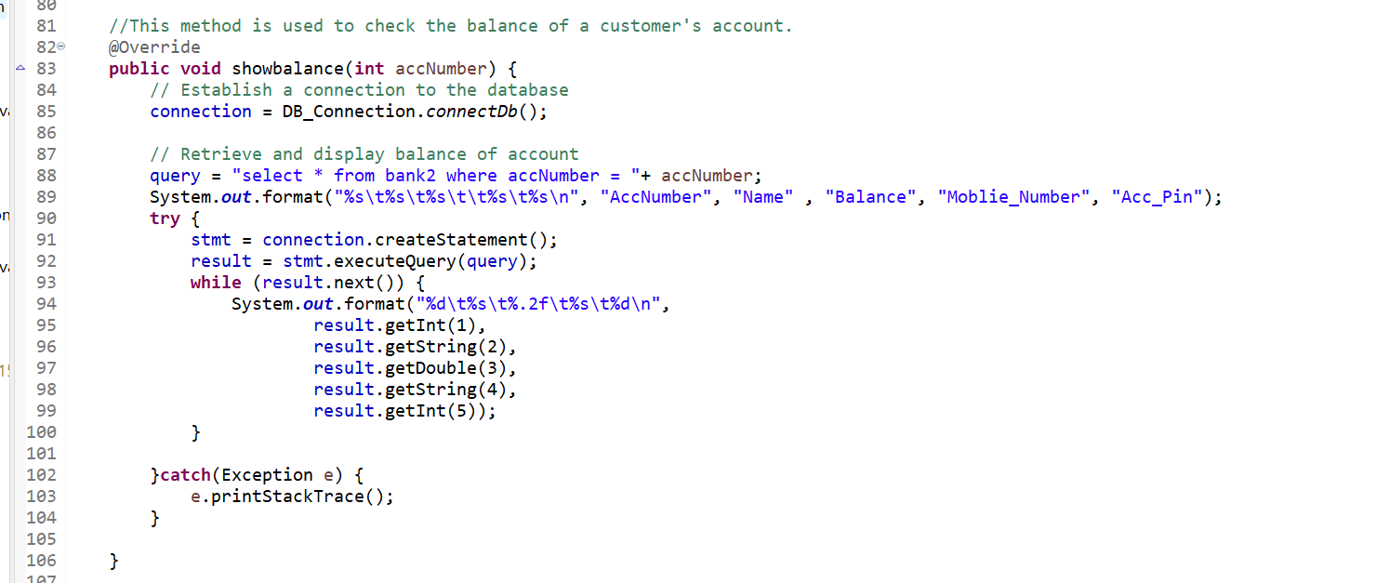
Source Code: Bank_Dao_Impl.java

Slide 20
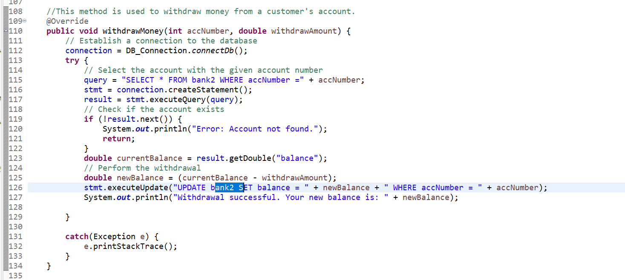
Source Code: Bank_Dao_Impl.java

Slide 21
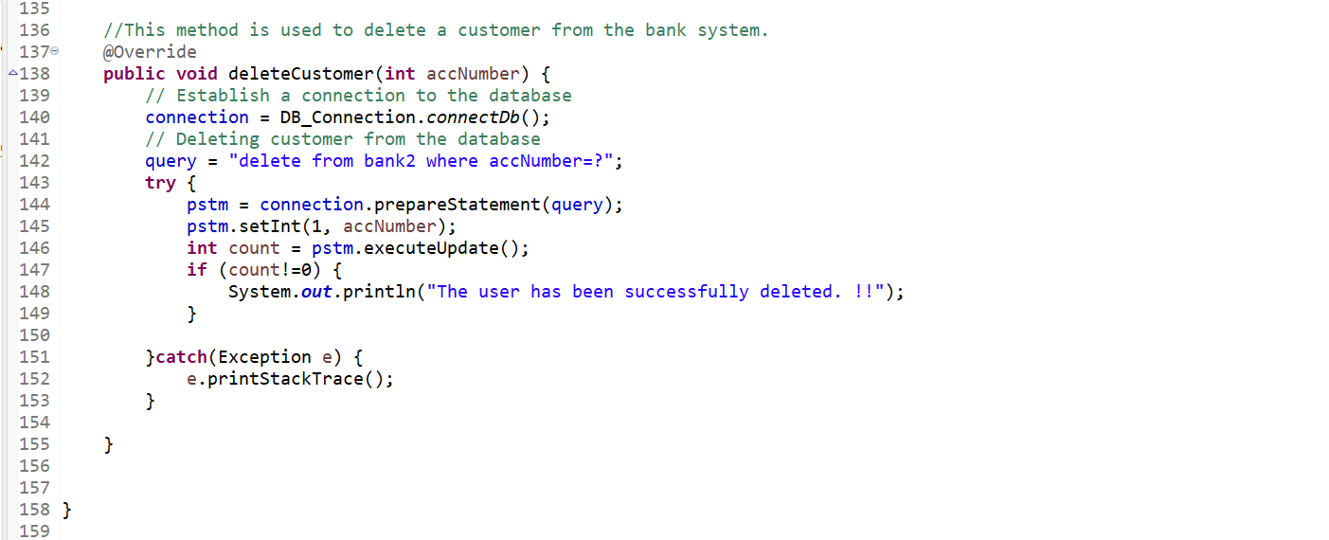
Source Code: Bank_Dao_Impl.java

Slide 22
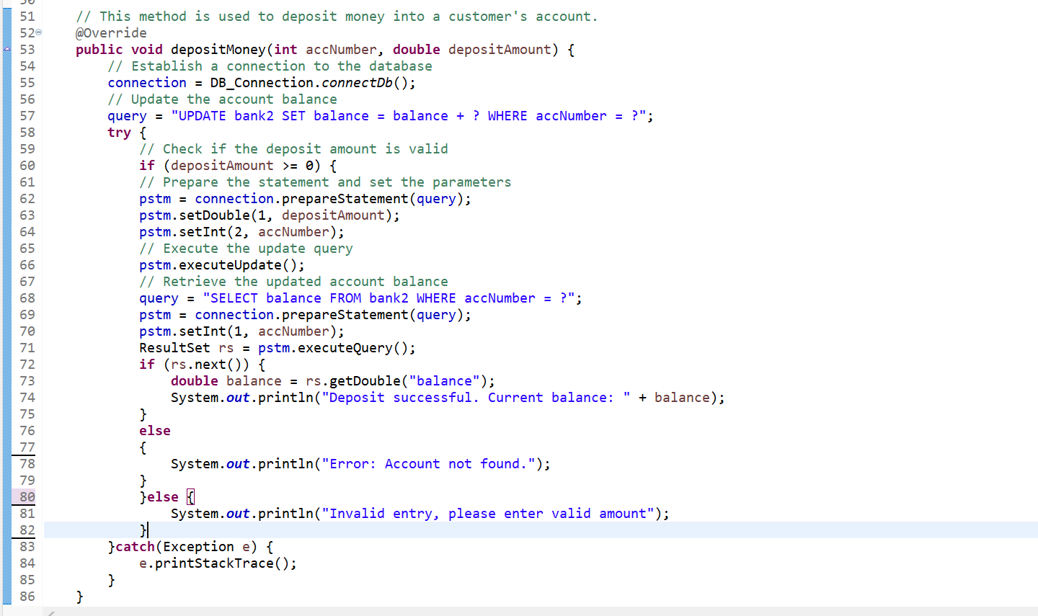
Source Code: Bank_Dao_Impl.java(version 2)

Slide 23
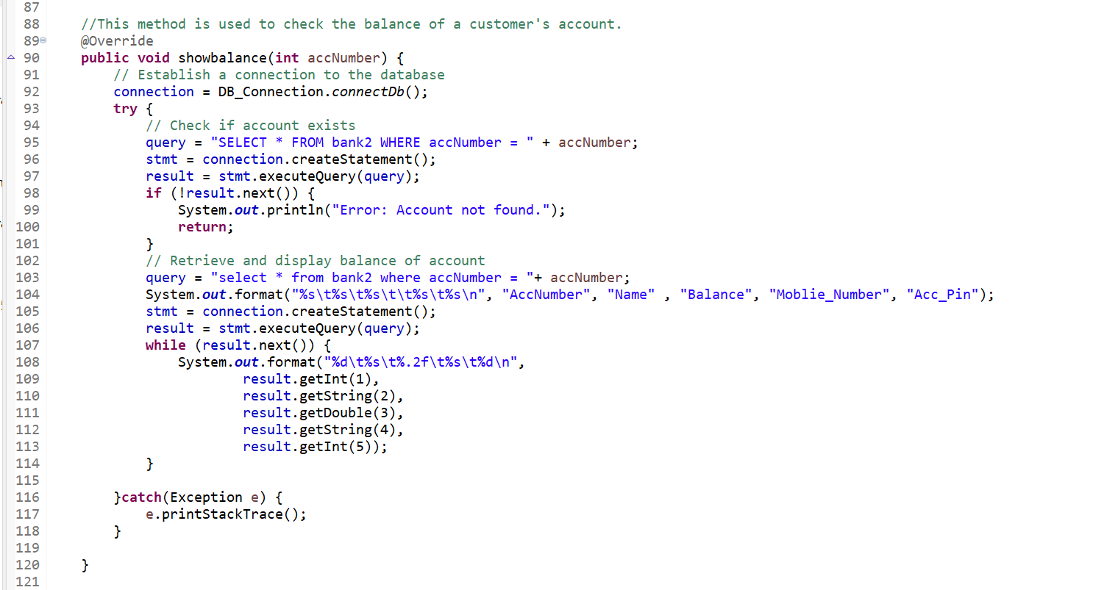
Source Code: Bank_Dao_Impl.java(version 2)

Slide 24
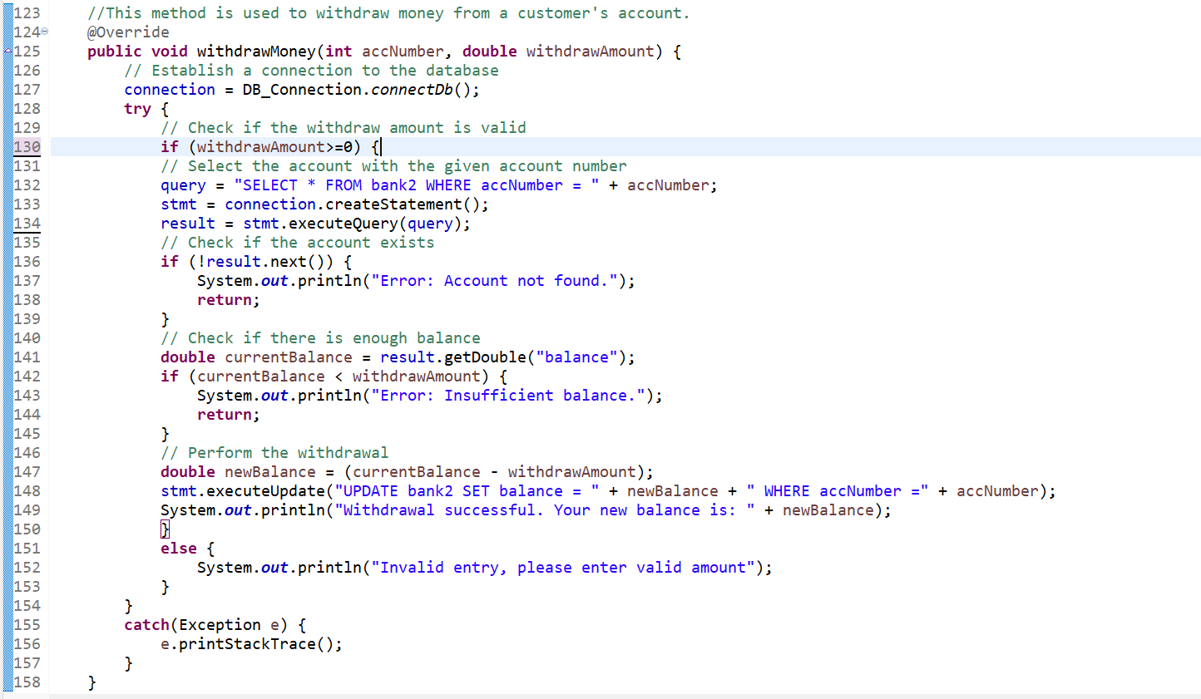
Source Code: Bank_Dao_Impl.java(version 2)

Slide 25
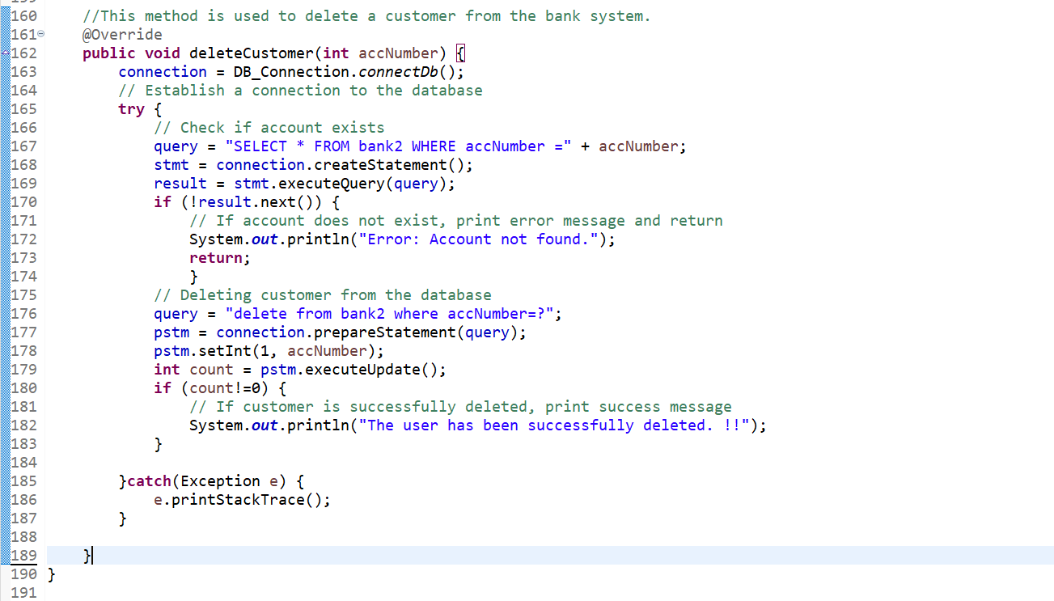
Source Code: Bank_Dao_Impl.java(version 2)

Slide 26
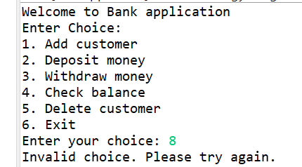
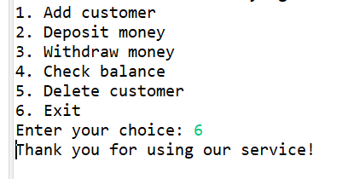
Console View: Module Choice
Invalid Choice of Module
Valid Choice of Module

Slide 27
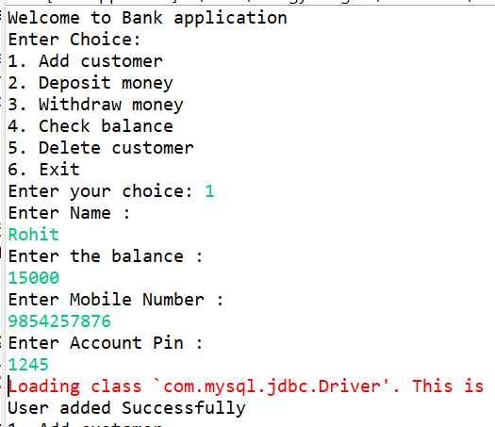
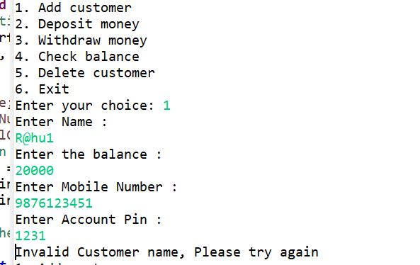
Console View: Adding Customers
Valid Details of Adding Customer
Invalid Details of Adding Customer

Slide 28
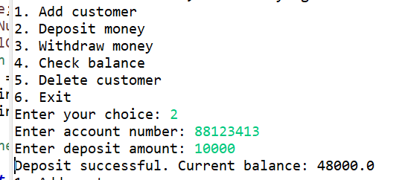
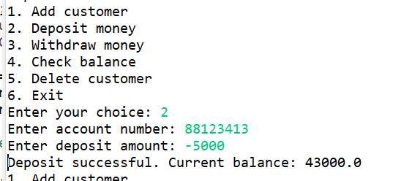
Console View: Deposit Money by Account Number
Valid details for deposit money
Defect in deposit money module

Slide 29
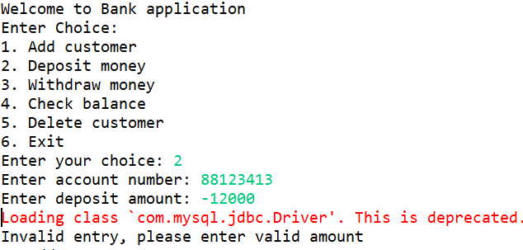
Console View: Deposit Money by Account Number ( version 2 ) without defect
deposit money module

Slide 30
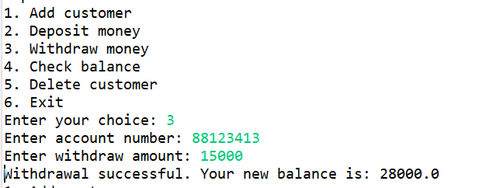
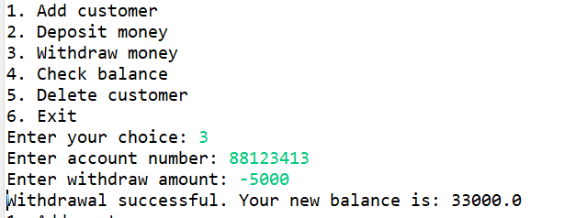
Console View: Withdraw Money by account number
Valid data for Withdraw Money
1St Defect in withdraw money module

Slide 31
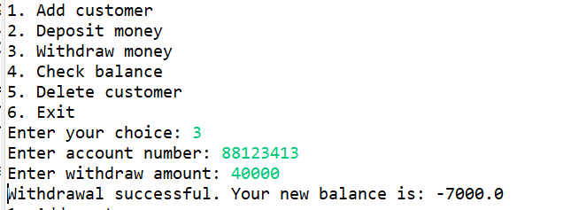
Console View: Withdraw Money by account number
2nd Defect in withdraw money module

Slide 32
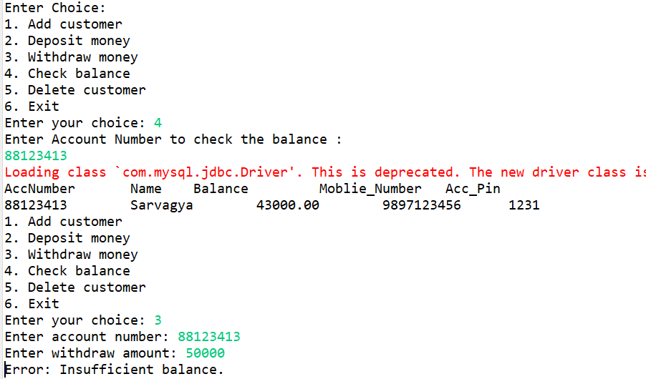
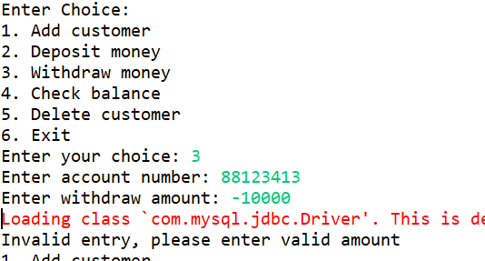
Console View: Withdraw Money by account number (Version 2) without defect

Slide 33
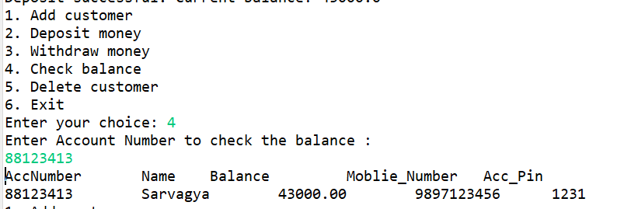
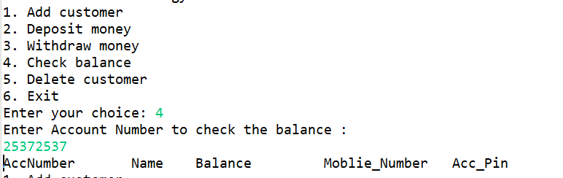
Console View: Check balance by account number
Valid data for check balance module
Defect in Check balance module

Slide 34
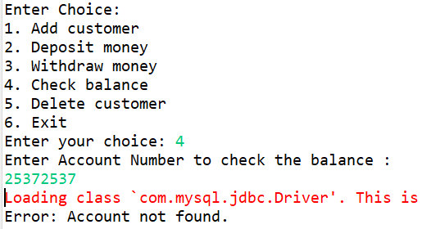
Console View: Check balance by account number (version 2) without defect

Slide 35
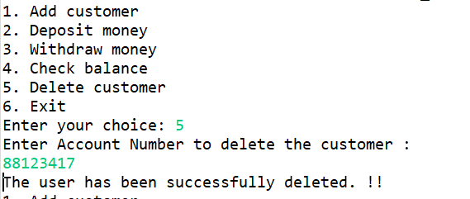
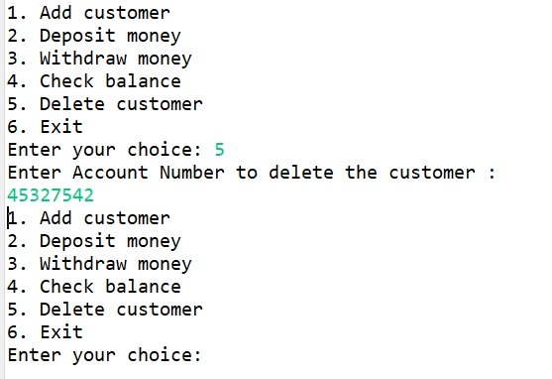
Console View: Delete customer by account number
Valid data for Delete customer module
Defect in Delete customer module

Slide 36
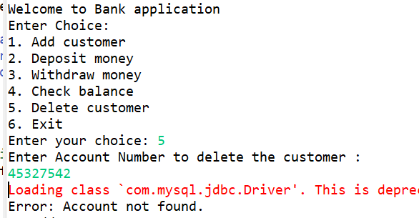
Console View: Delete customer by account number (version 2) without defect

Slide 37
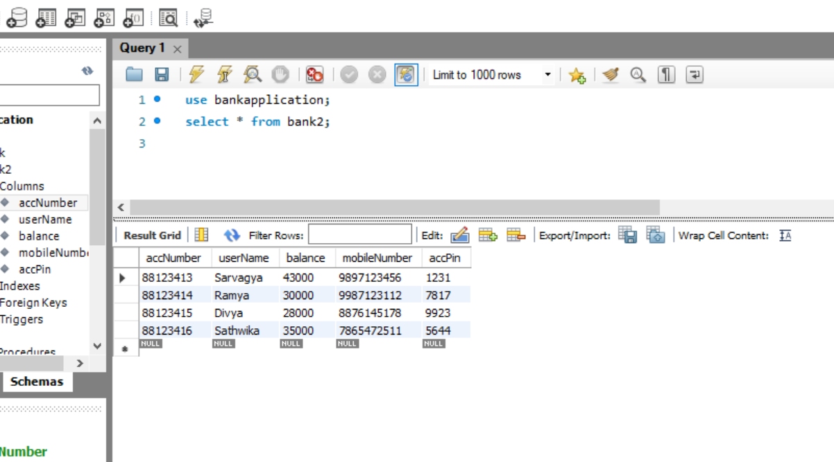
Application Database:

Slide 38
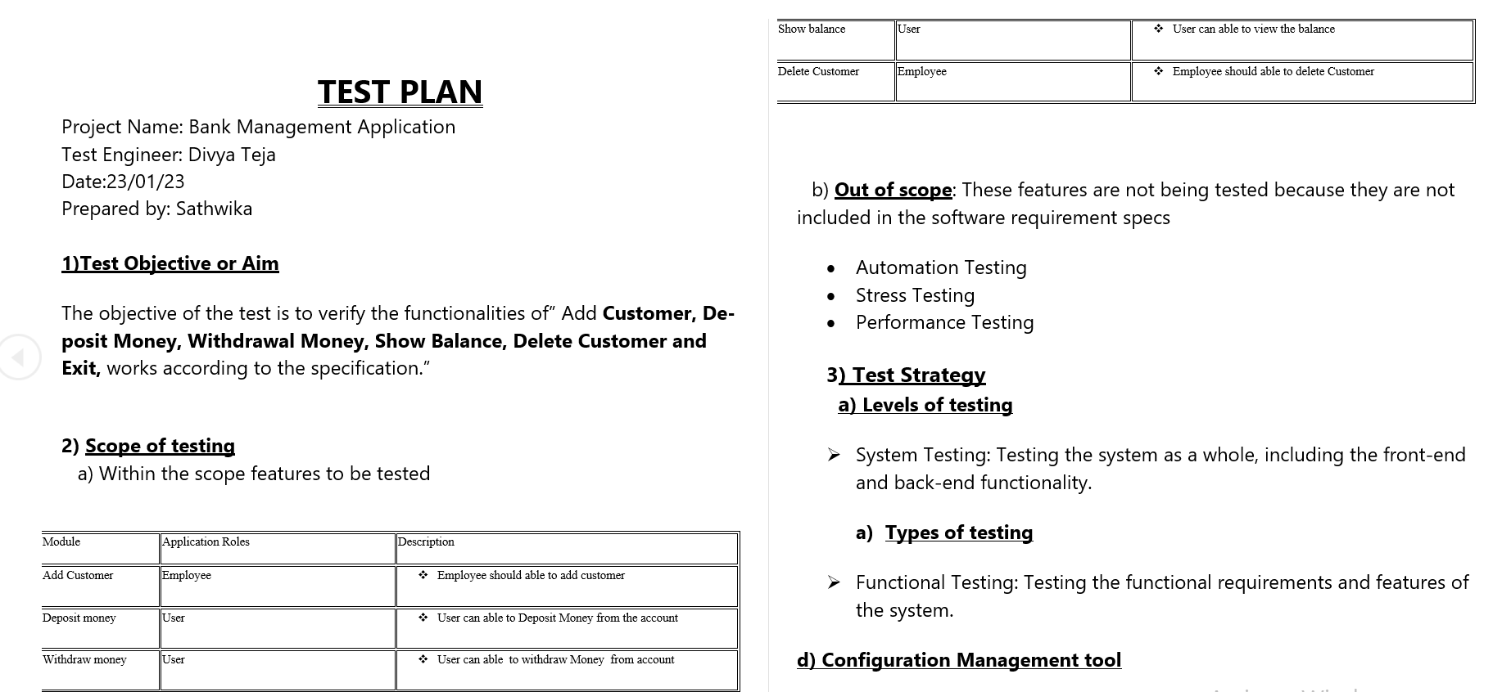

Slide 39
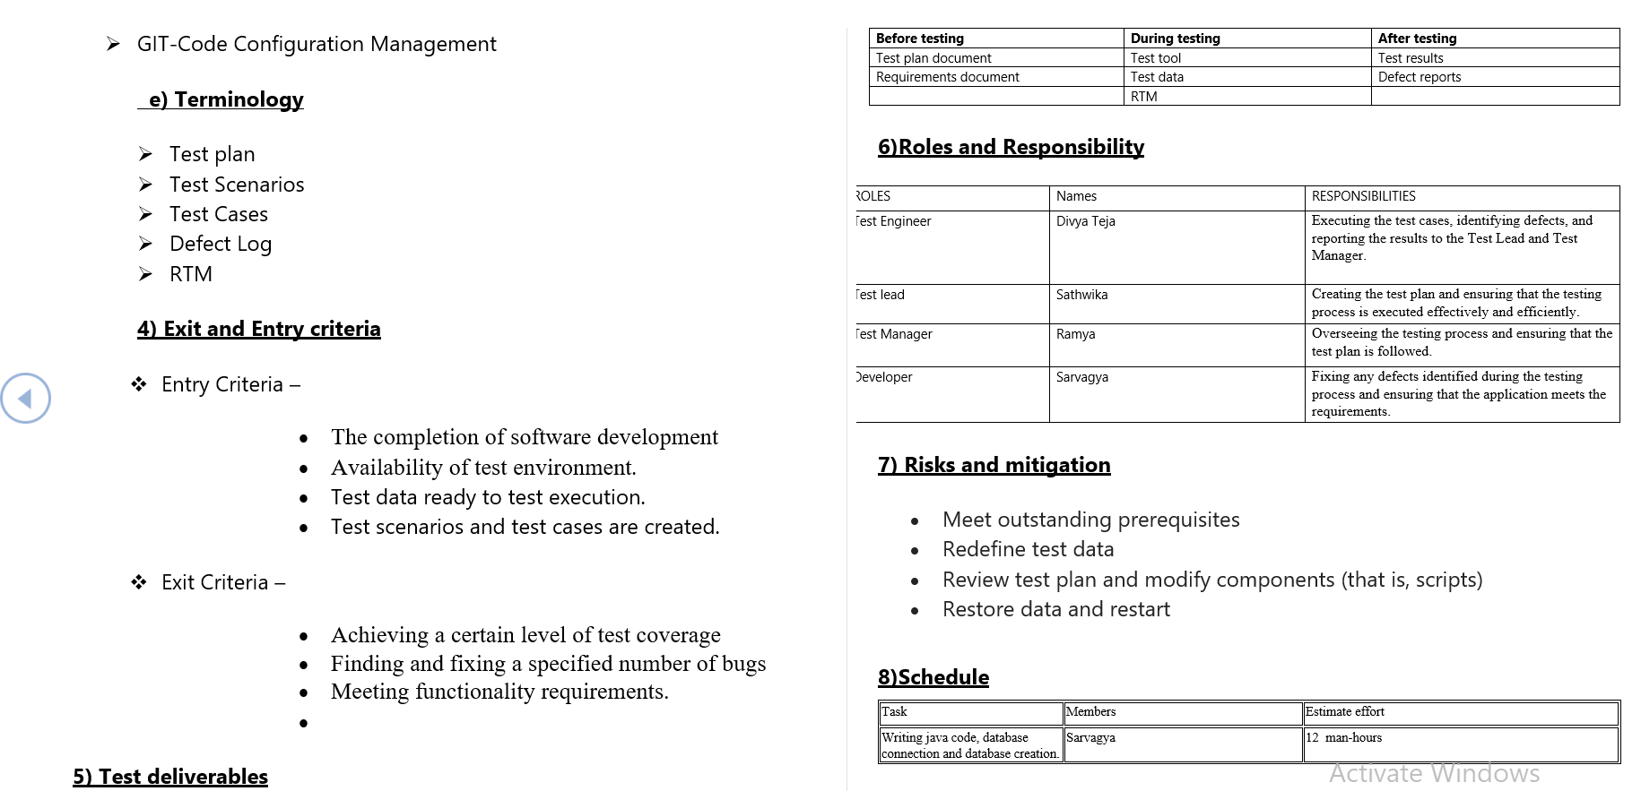

Slide 40
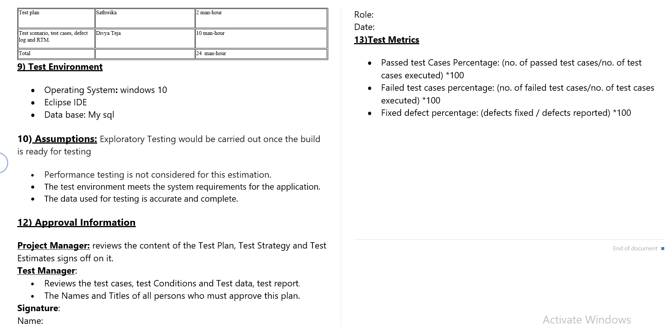

Slide 41
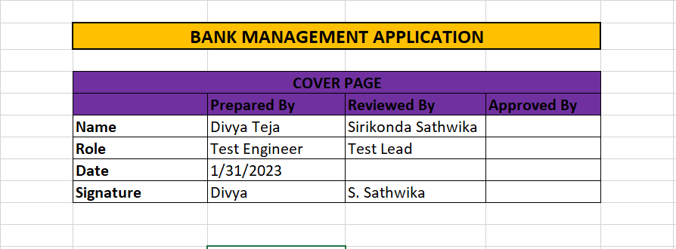
Cover Page

Slide 42
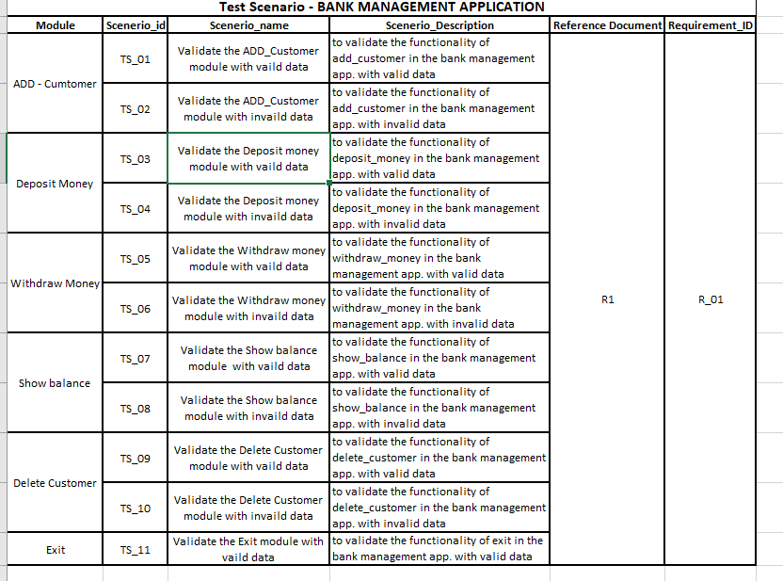
Test Scenario

Slide 43
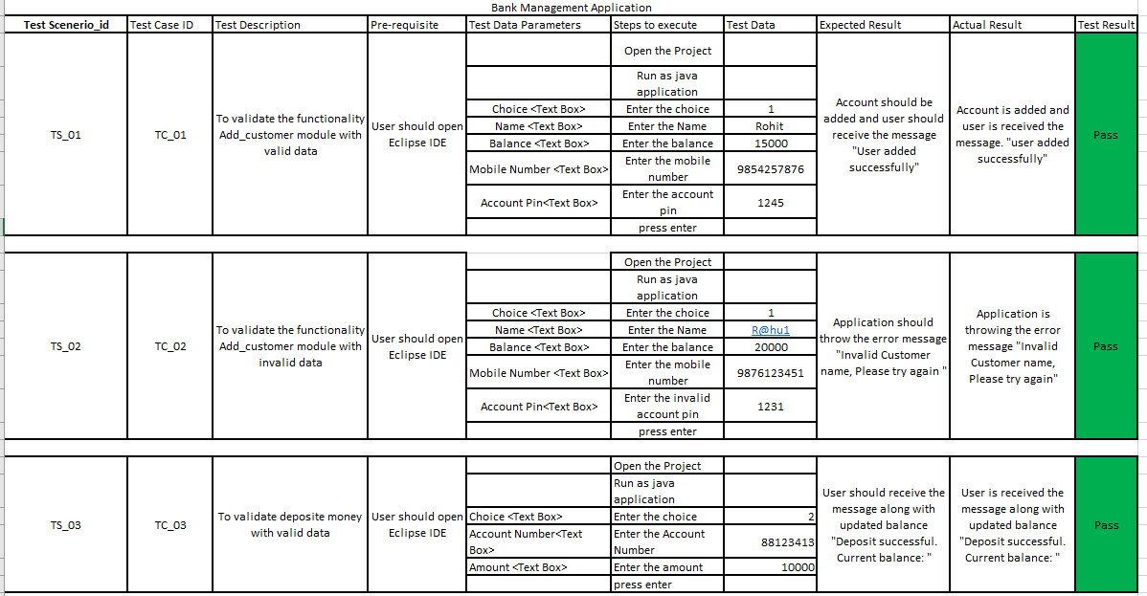
Test Cases

Slide 44
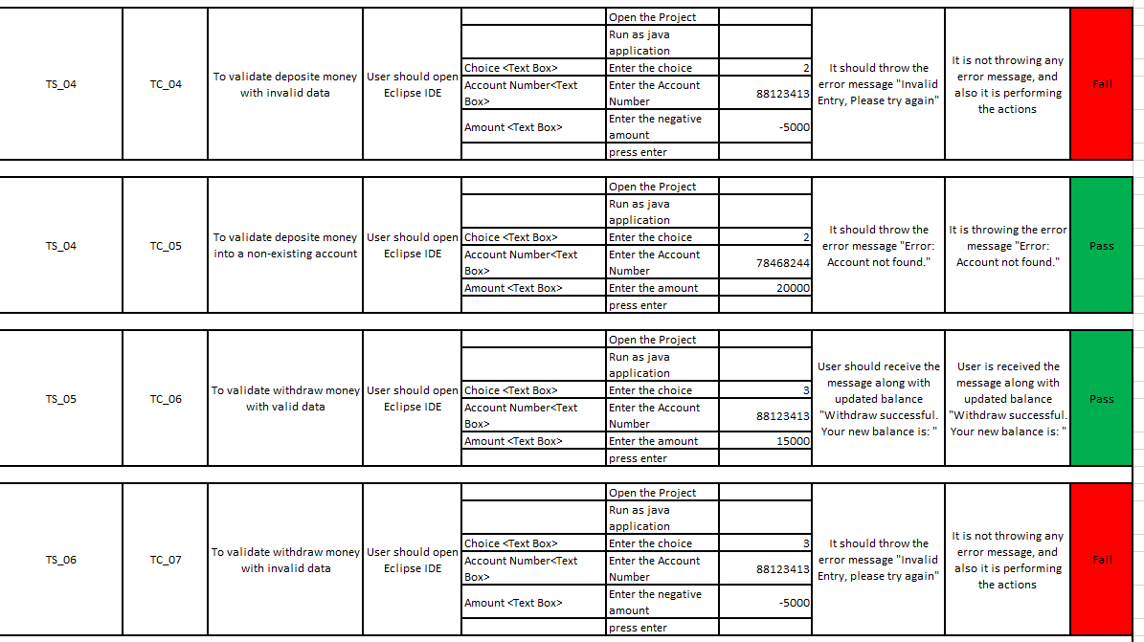
Test Cases

Slide 45

Test Cases

Slide 46

Test Cases

Slide 47

Defect Log

Slide 48

Defect Log

Slide 49

Defect Log

Slide 50

RTM

Slide 51
AUTOMATION TESTING FOR MACD Website

Slide 52


Structure Of The Project

Slide 53

Base Class Code

Slide 54

Base Class Code

Slide 55

Page Object Class For Home Page

Slide 56

Page Object Class For Home Page

Slide 57

Page Object Class For Home Page

Slide 58

Page Object Class For Home Page

Slide 59

Page Object Class For Cart page

Slide 60

Page Object Class For Cart page

Slide 61

Page Object Class for Customization page

Slide 62

Page Object Class for Customization page

Slide 63

Page Object Class for Customization page

Slide 64

Page Object Class for Location page

Slide 65

Page Object Class for Location page

Slide 66

Page Object Class for Location page

Slide 67

Page Object Class for Location page

Slide 68

Source Code For Test Case 1

Slide 69

Source Code For Test Case 1

Slide 70

Source Code For Test Case 2

Slide 71

Source Code For Test Case 2

Slide 72

Source Code For Test Case 3

Slide 73

Source Code For Test Case 3

Slide 74

Source Code For Test Case 4

Slide 75

Source Code For Test Case 5

Slide 76

Source Code For Test Case 5

Slide 77

Source Code For Data Provider Class

Slide 78

Source Code For Data Provider Class

Slide 79

Source Code For Data Provider Class

Slide 80

testng xml file

Slide 81

Emailable-report

Slide 82

Emailable-report

Slide 83

Extent Report

Slide 84
GitHub Link
Console Project :
HTTPS: https://github.com/sarvagyasinghal30/Bank_Management.git
SSH Link: git@github.com:sarvagyasinghal30/Bank_Management.git
GitHub CLI: gh repo clone sarvagyasinghal30/Bank_Management
Automation project:
HTTPS: https://github.com/sarvagyasinghal30/Automation_Project_Macd.git
SSH Link : git@github.com:sarvagyasinghal30/Automation_Project_Macd.git
GitHub CLI : gh repo clone sarvagyasinghal30/Automation_Project_Macd

Slide 85


